Slide 1
Playful Design Hackers
HMC Hackathon

Slide 2
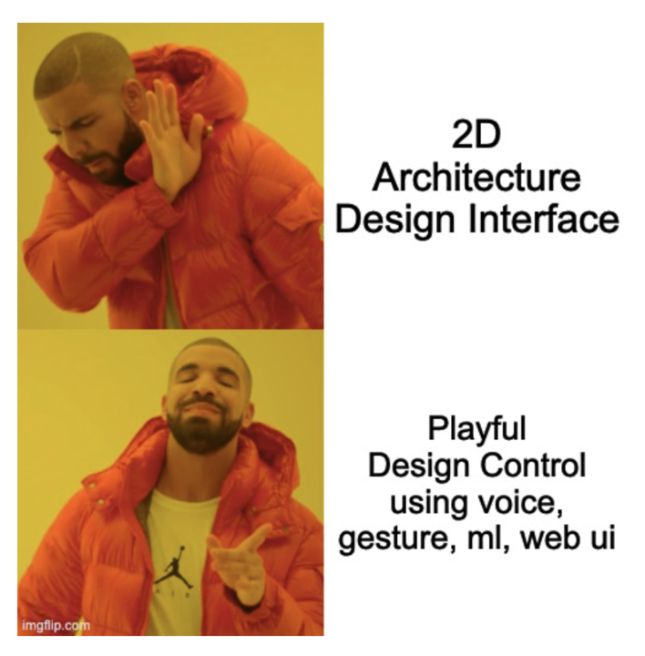


Slide 3
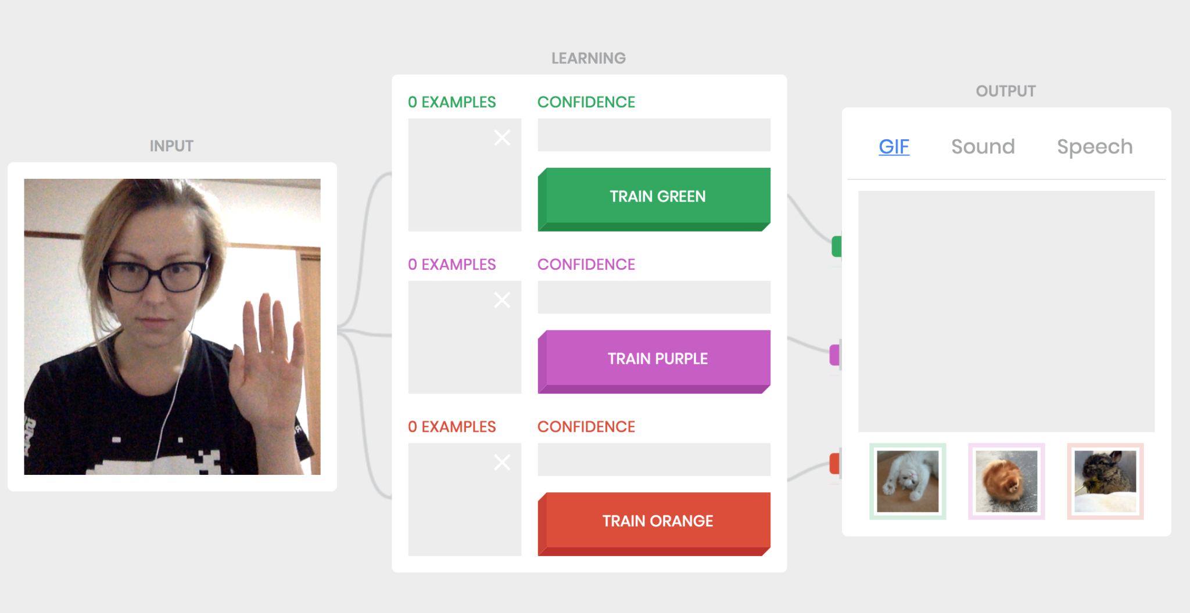
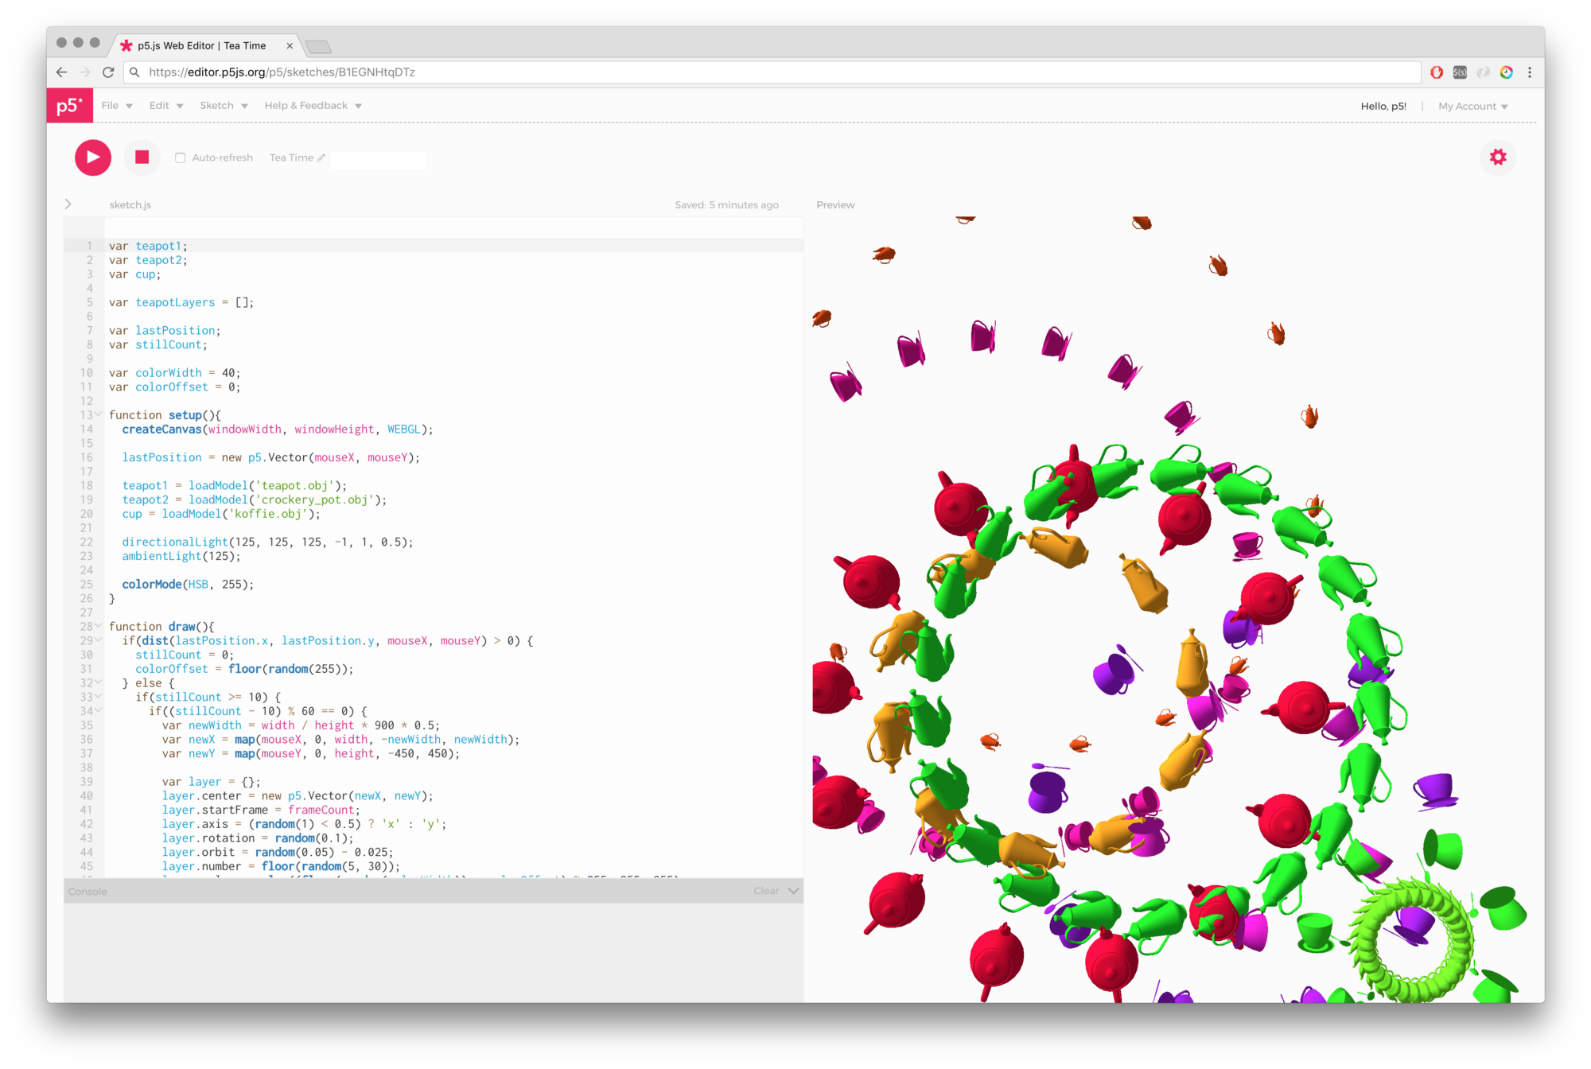
Workflow
CreativeML/ Python CV/ Tensorflow.js/ ml5.js/ TF lite
Rhino Hops
Python script
Geometry Input Parameters for Manipulation
Grasshopper Script
Import Library/ Models
We developed a Bridge using websocket that can integrate any modes of data(vision, voice, gesture) from any medium(website,py,js) and integrate opensource libraries to facilitate creative workflows.
Script Web Interface and Gh Script Hops Open-sourced
https://editor.p5js.org/mistrymm7/sketches/M_BT0xHty
https://editor.p5js.org/mistrymm7/sketches/2LIacVhqt
https://teachablemachine.withgoogle.com/assets/prediction.mp4

Slide 4
Geometric Modelling using Sketch
Live DEMO

Slide 5
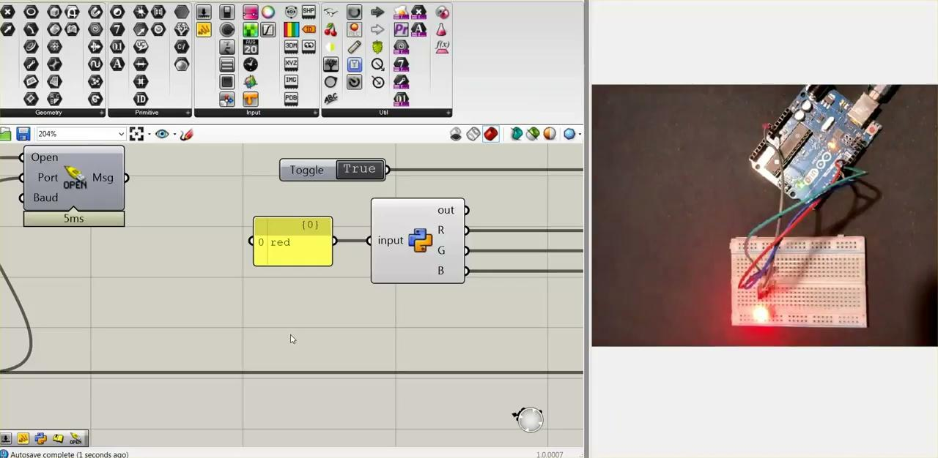
Voice controlled microcontrollers
https://editor.p5js.org/mistrymm7/sketches/2LIacVhqt
Video

Slide 6
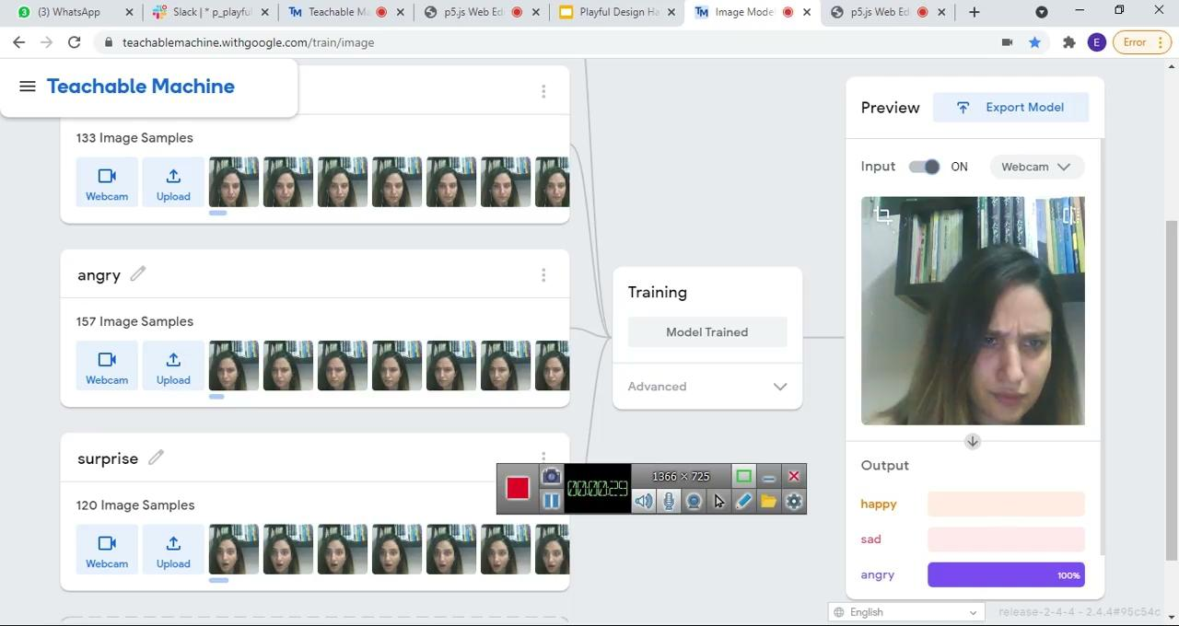

Spatial Evaluation using Emotions

Slide 7
Emotion detection

Slide 8
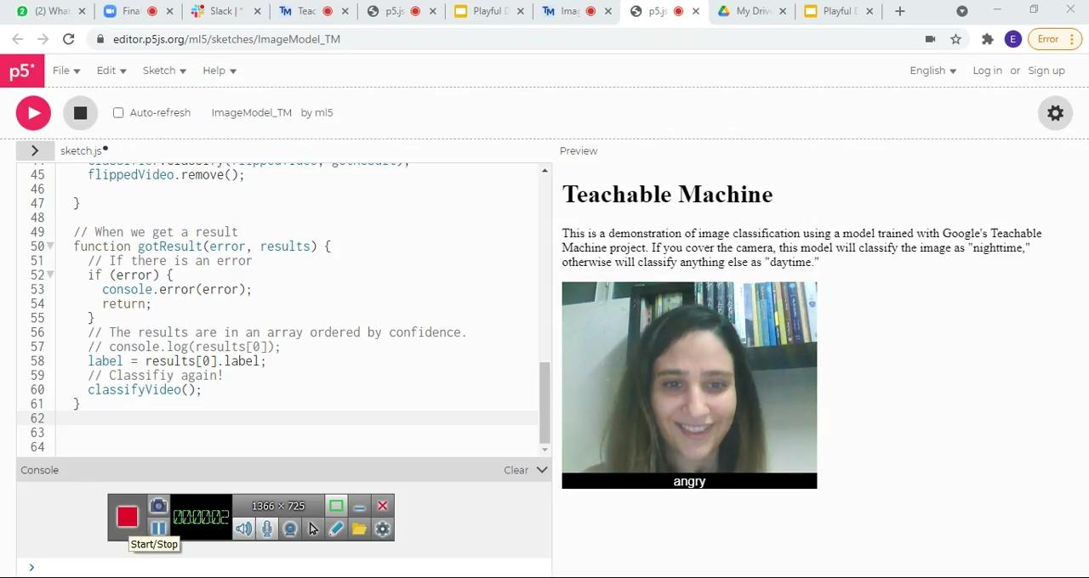

Slide 9
Next steps
Ml5.js, p5.js, Teachable Machine ML Plugin release on food4rhino
Interactive machine learning design workflow start to end browser based and migrate to Rhino appserver Cloud compute
Integrate different discipline pipelines

Slide 10



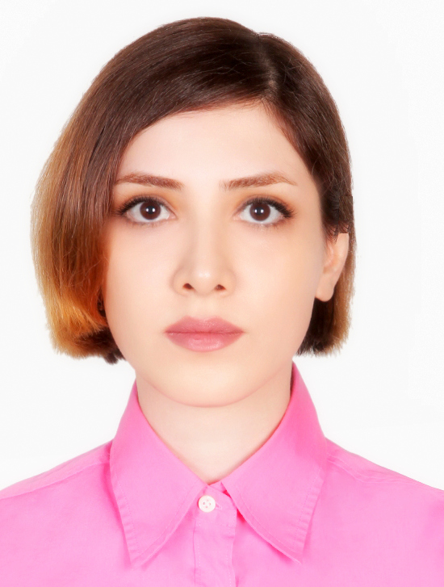



Team Pic Slide
Mayur
Mistry
Mehrzad
Samadi
Tuli
Bhattacharjee
Atrin
Poursadrollah
Elham
Ghaderi
Richa
Gupta
Sahil
Tadwalkar

Slide 11
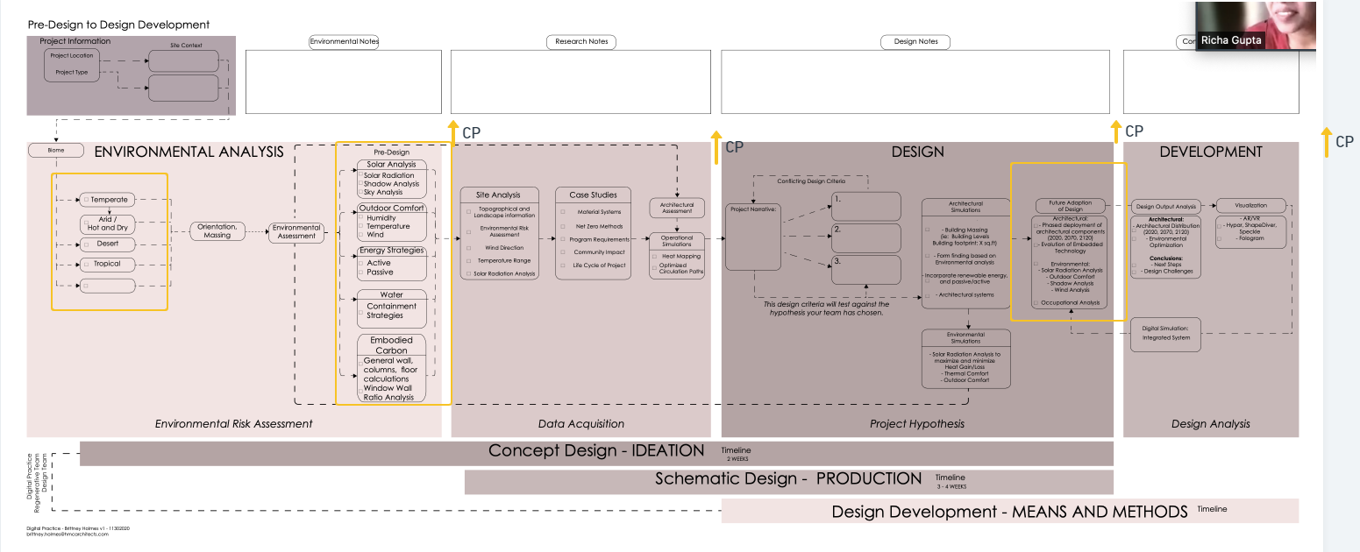
CDM

Slide 12

Feedback of the user via building camera & include it as evidence based data for further designs of other building

